Slide 1

Travel Experts
Impact IT
Winter 2019

Slide 2

Presentation Outline
Introductions
Products
Desktop
Website
Mobile
Demonstration
Q & A

Slide 3

INTRODUCTIONS
Impact IT
Louise Acosta
洪笠铭 （LiMing Hong）
Colin Lee-Chee
Hayley Mead

Slide 4
SOFTWARE COMPOSITION
THE PRODUCT CONSISTS OF TWO SOFTWARE BUNDLES
DESKTOP APPLICATION
WEBSITE
MOBILE SERVICE
User functionality
Office application
Website
Agent UX
Database
Customer UX
Features
Functionality

Slide 5

OFFICE APPLICATION
JAVA DESIGN WITH JSP SERVER
The desktop application is designed to support Travel Agents staff with the following features:
Allow agents to manage the website for internal business requirements
Allow agent to control current bookings

Slide 6

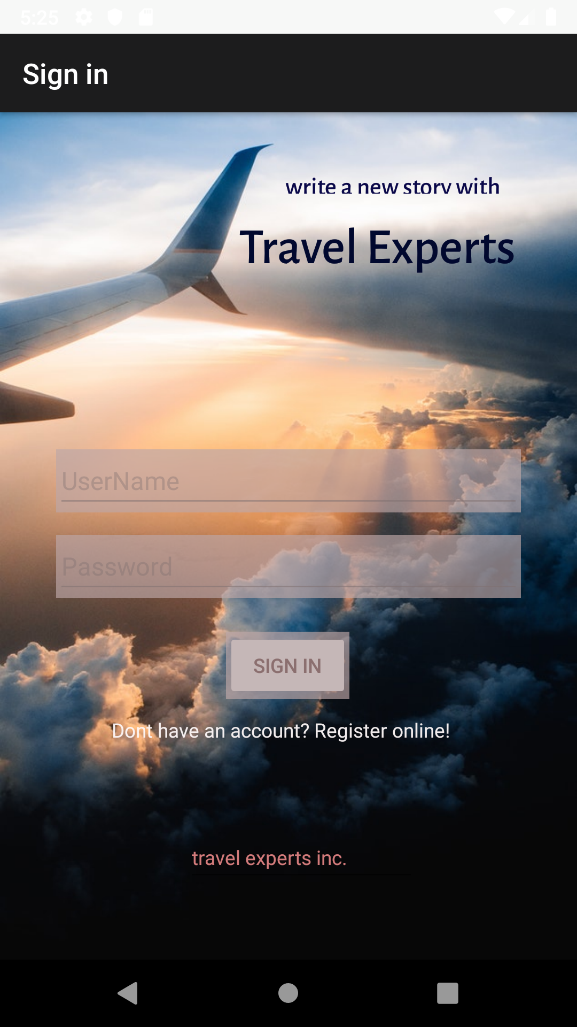
WHERE DO YOU WANT TO GO?
Mobile Application

Slide 7
OVERALL
Here is the cost break down of the project.
30%
25%
20%
Base Package
Desktop App
Android Service
10%
7%
3%
Additional Features
1st Year Service
Extended Service

Slide 8

Thank you for listening

Slide 9

HAVE A NICE DAY!
Impact IT
Phone:
403-667-5788
Email:
INQUIRIES@IMPACT_IT.COM

Slide 10
TODO:
DETERMINE PRICING (SLIDE 8)
DETERMINE PRESENTATION ROLES
WALK THROUGH PRESENTATION

